Slide 1

Oracle HCM Project Next Academy
Project Module:- Oracle Core Module.
Company Name:- LA Company
Company Industry:- Software and Mobile Applications.
Teamwork:-
Yomna Muhammad Khattab
Alaa Essam Ali
Mohamed Medhat Mostafa
Ayman Ahmed Shawky

Slide 2

About LA Company
Established 2006.
Specialized in Custom Website Development, Integrated E-Commerce Solutions​, Mobile Application Development, And Search Engine Optimization SEO.
Manpower average of 51-100 Employees.
Head offices in Egypt.

Slide 3

Oracle HCM Implementation Objectives
After several meetings and according to CRP 1 meeting, We can summarize the objectives as follows:-
Enables the workforce to use a web browser to access HR information and perform personnel actions systematically.

Slide 4
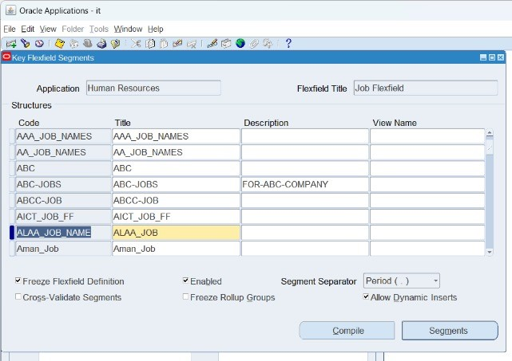
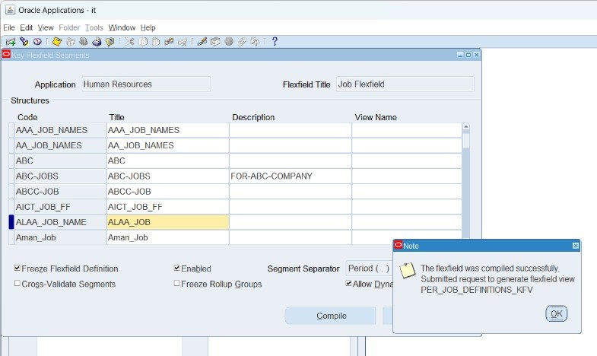
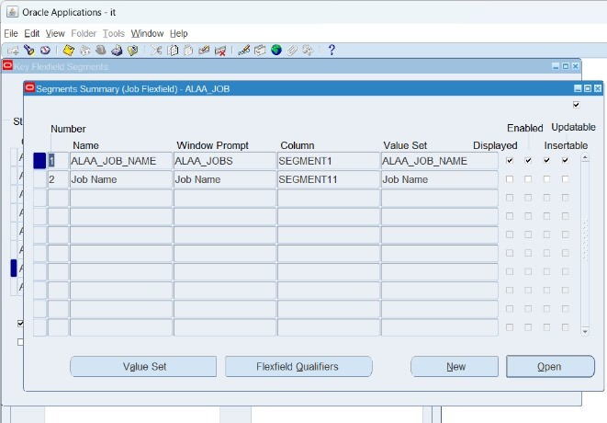
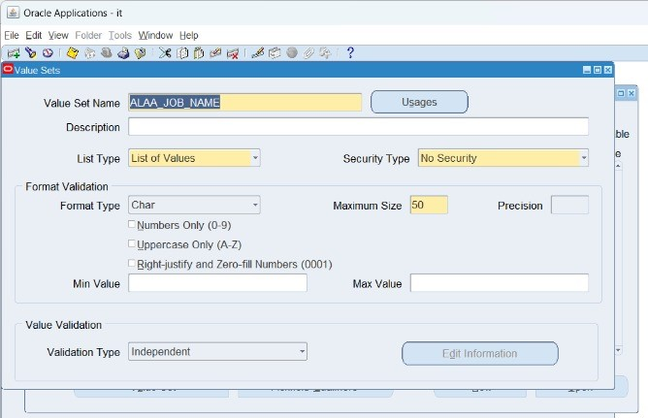
Creating Business Group
To create a Business Group, We have to create Keys Flexfield as follows:-
Job Flex Field & Job Value Set

Slide 5
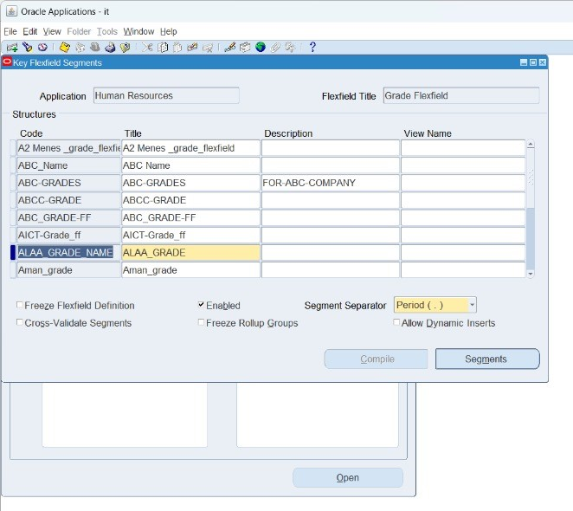
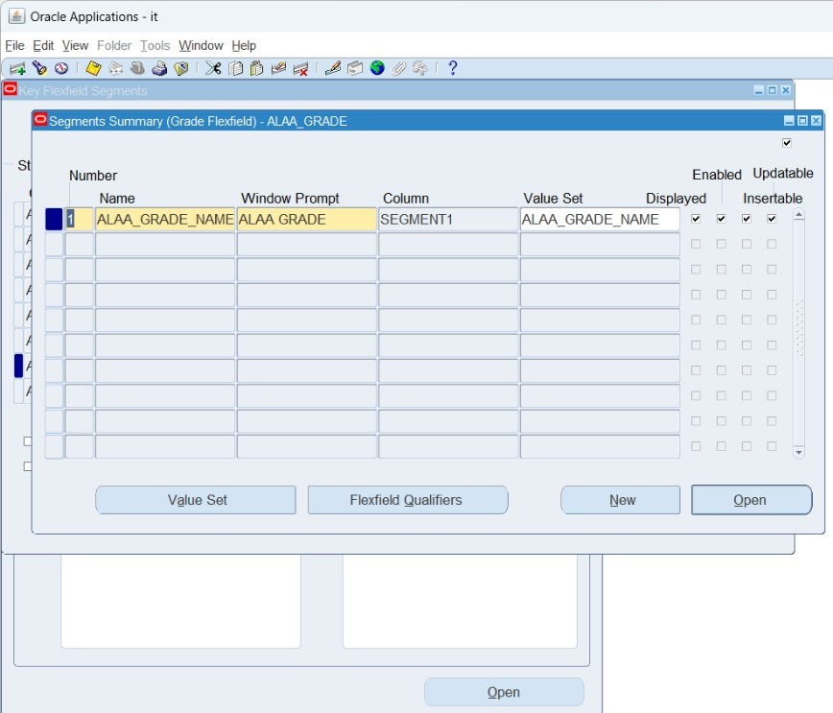
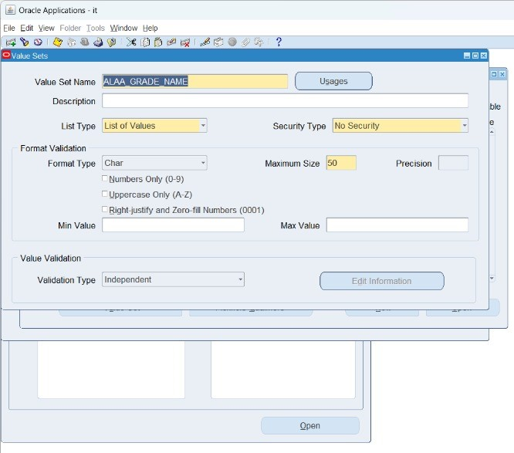
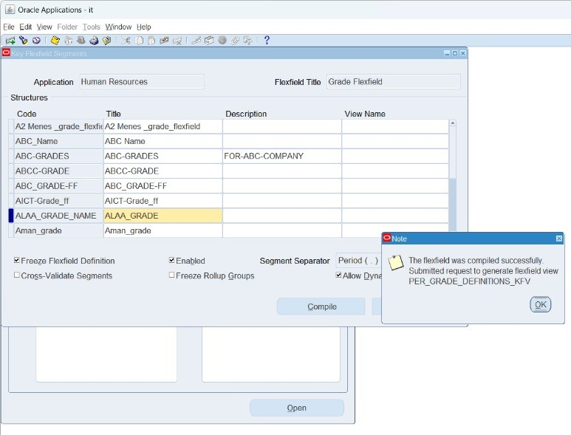
Continue Creating keys flex field
Grade Flex Field & Grade Value Set

Slide 6
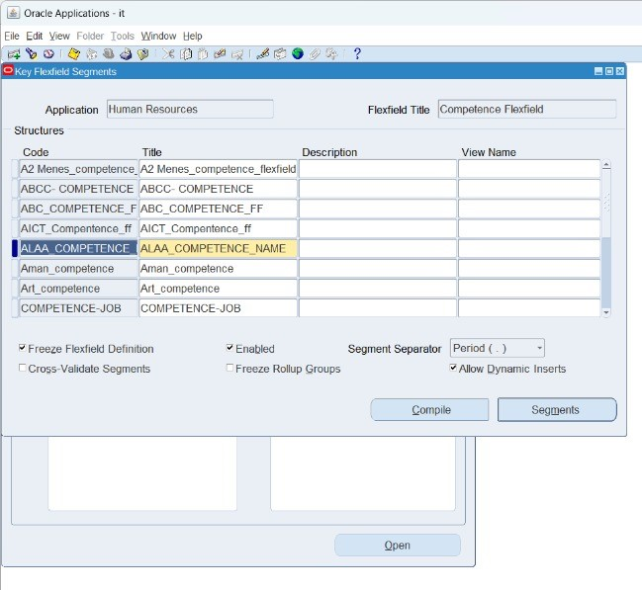
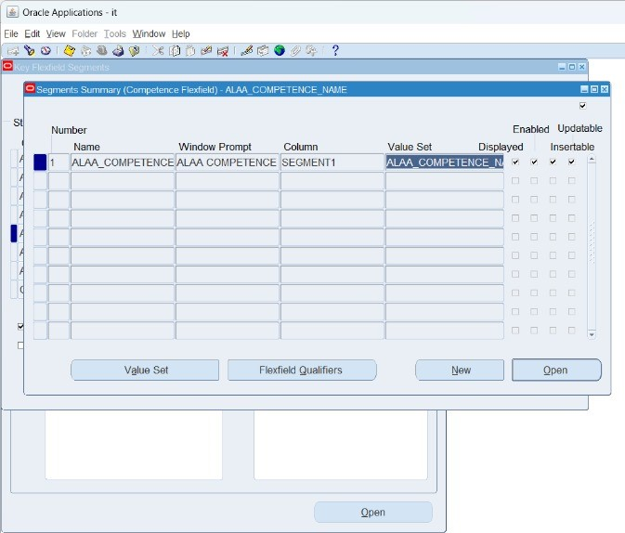
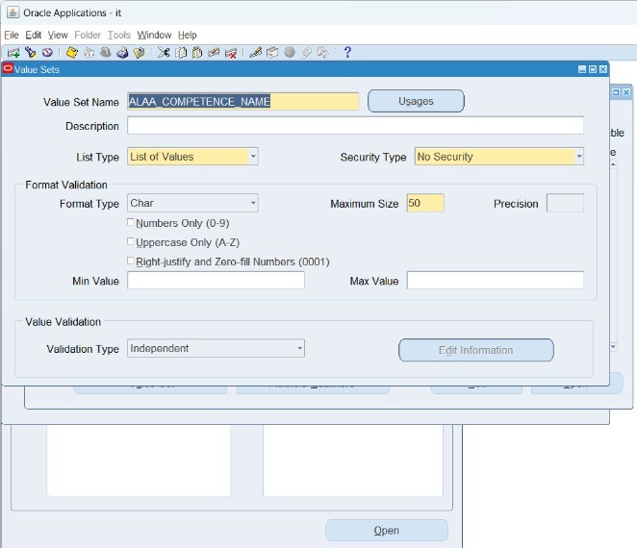
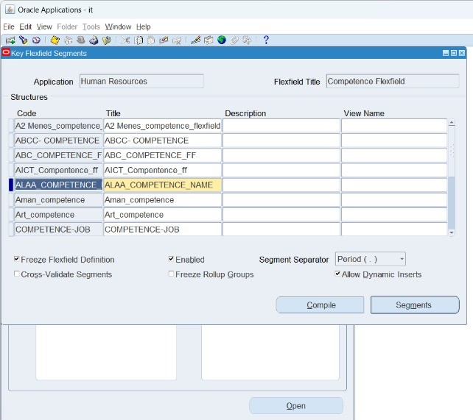
Continue Creating keys flex field
Competency Flex Field & Competency Value Set

Slide 7
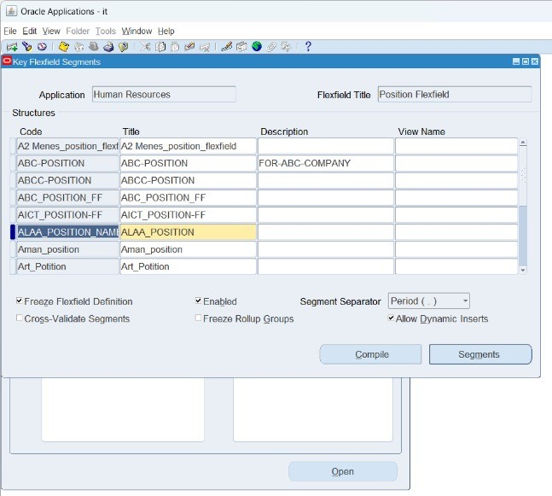
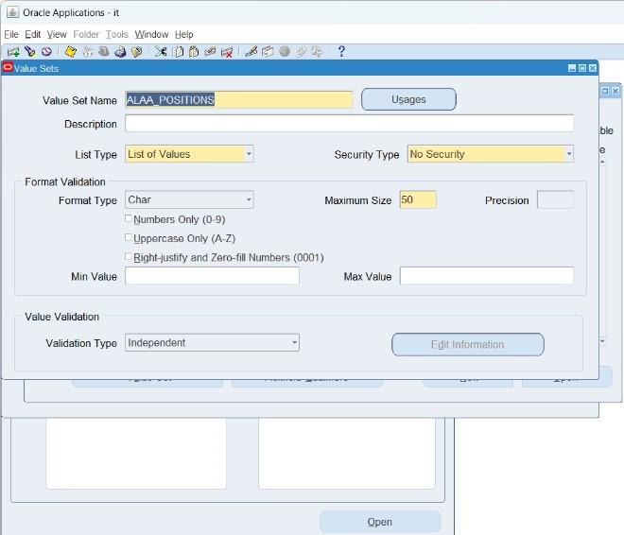
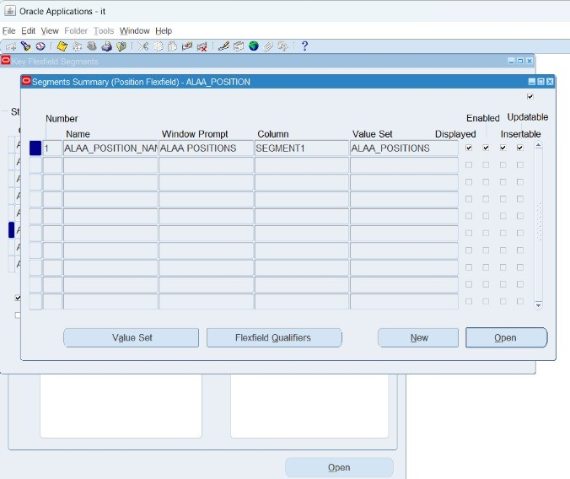
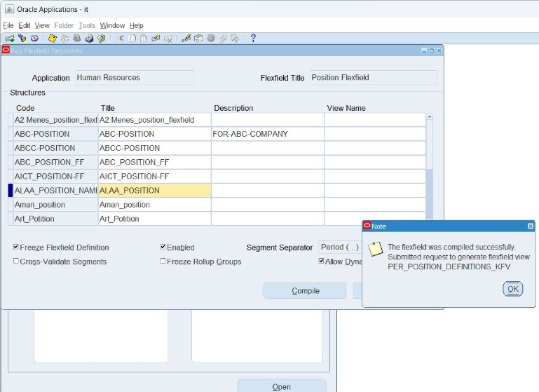
Continue Creating keys flex field
Position Flex Field & Position Value Set

Slide 8
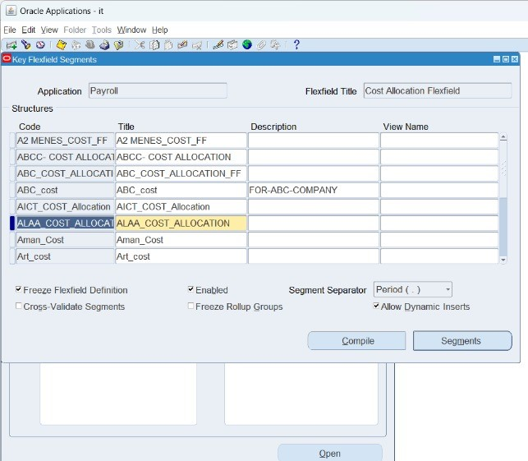
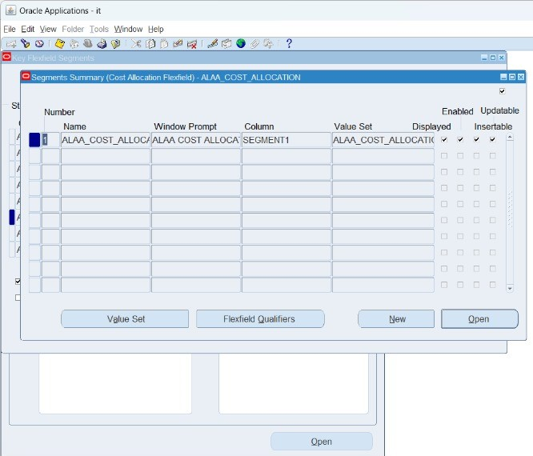

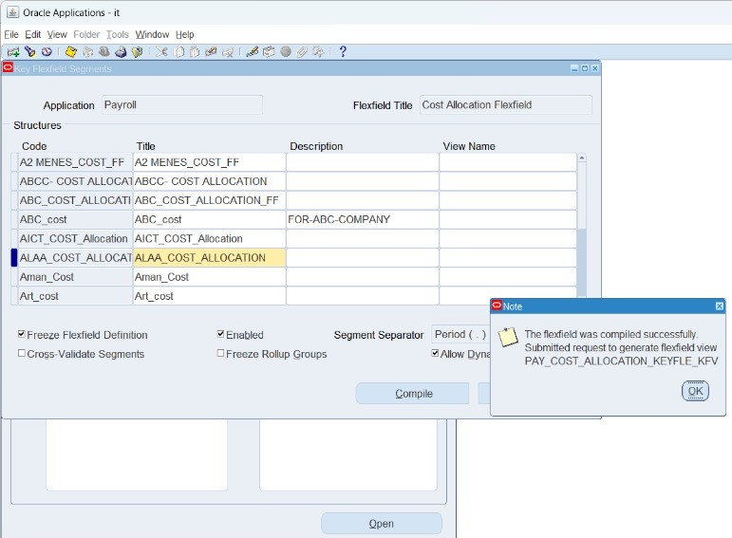
Continue Creating keys flex field
Cost Allocation Flex Field & Cost Allocation Value Set

Slide 9
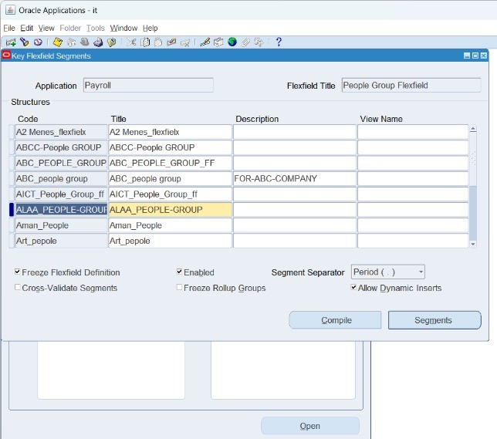
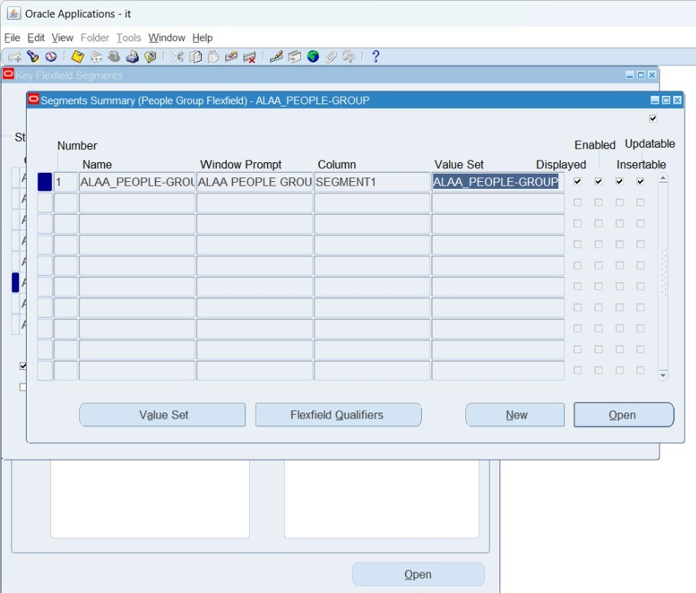

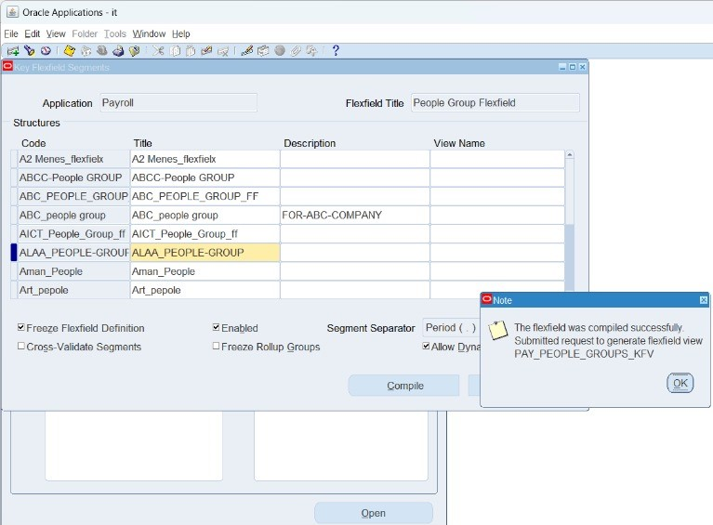
Continue Creating keys flex field
People Group Flex Field & People Group Value Set

Slide 10
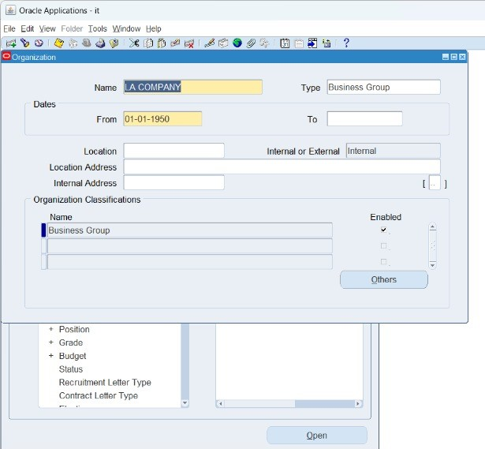
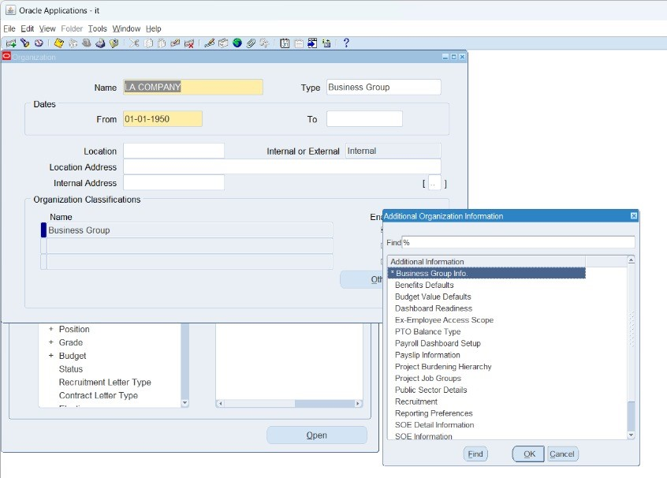
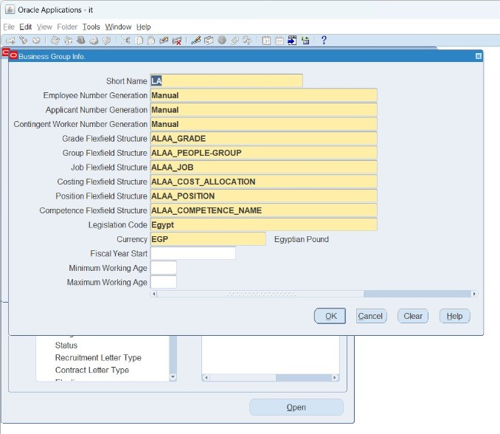
Creating Business Group
After creating Keys Flex Field, Now we are ready to create LA Company as a legal entity – Business Group as follows:-

Slide 11
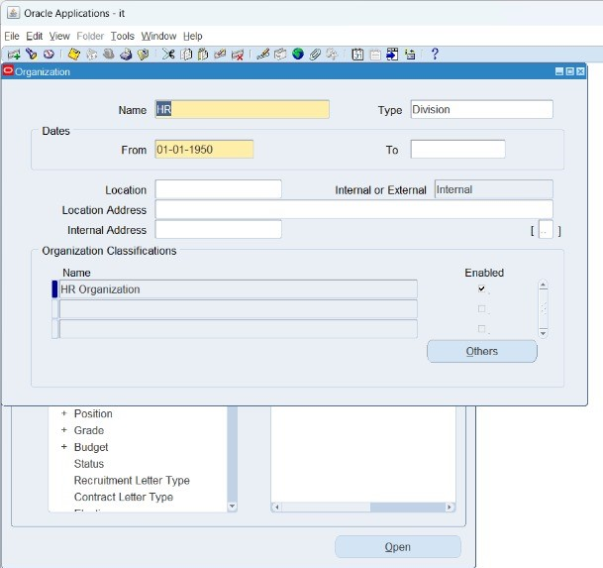
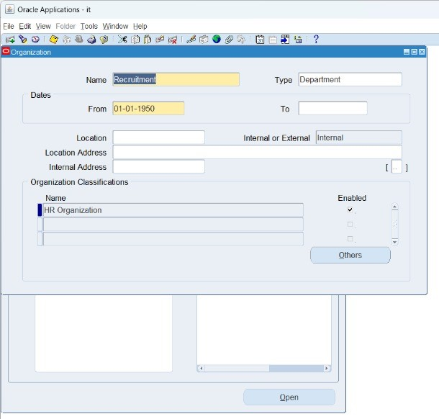
Creating Divisions, Managements, Sections, and Departments
According to the company’s industry and company’s vision, mission and objectives, We can create the Organization Chart which contains Divisions and Management and its subsidiaries departments, for example:-

Slide 12
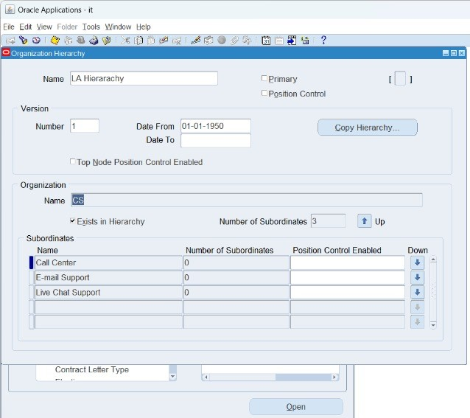
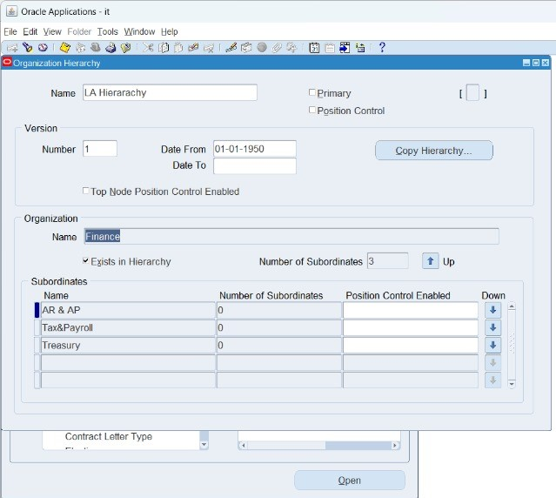
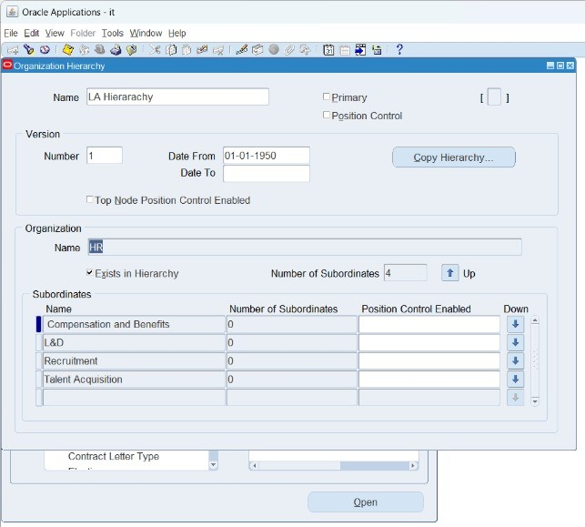
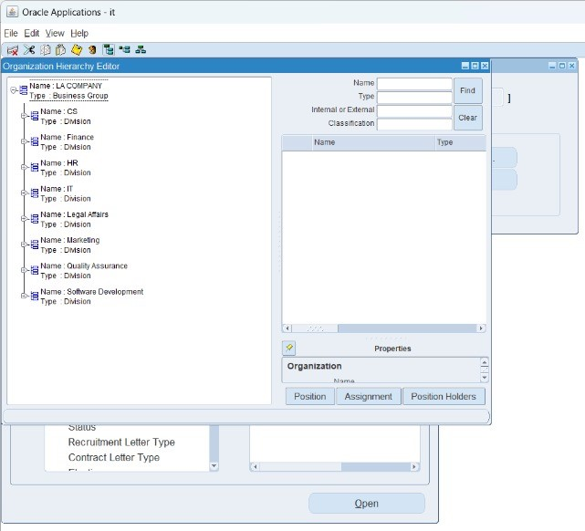
Now we can create the hierarchy as follows:-

Slide 13
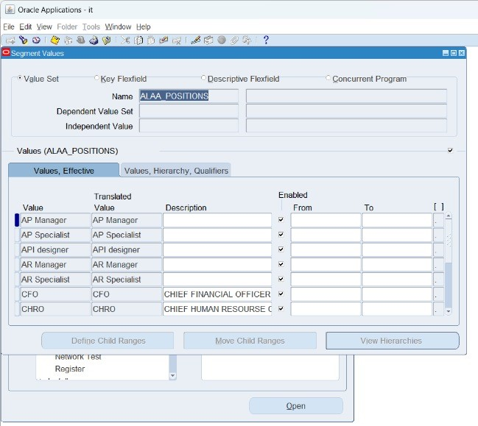
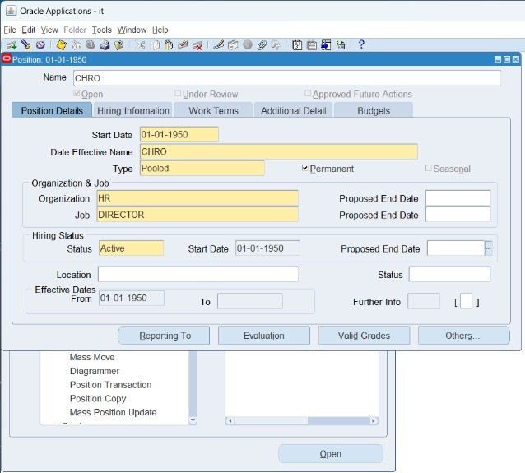
Creating value set
After creating Key Flex Field, We have to create Value set for all of them as follows:-

Slide 14
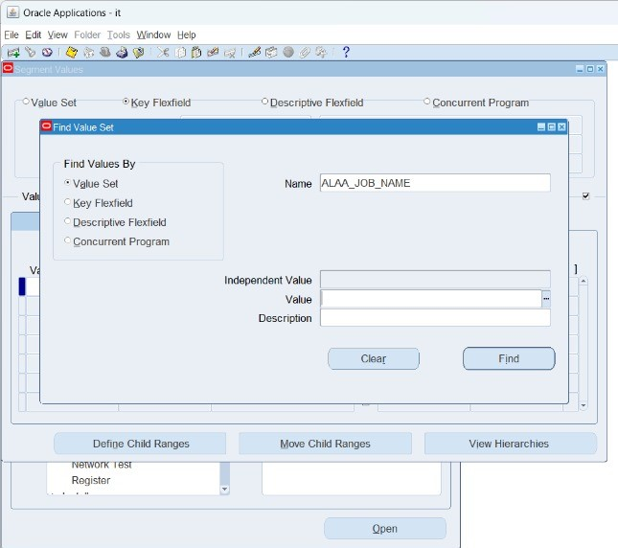
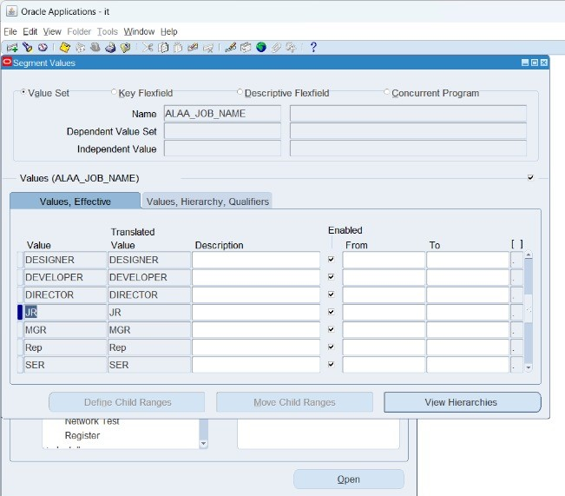
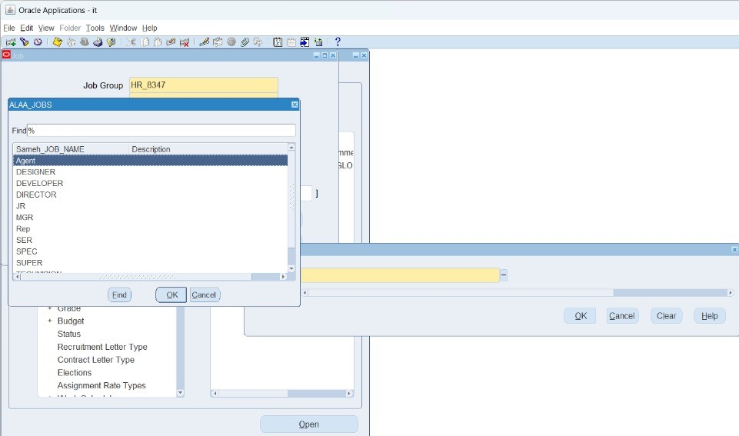
Continue Creating value set
After creating Key Flex Field, We have to create Value set for all of them as follows:-

Slide 15
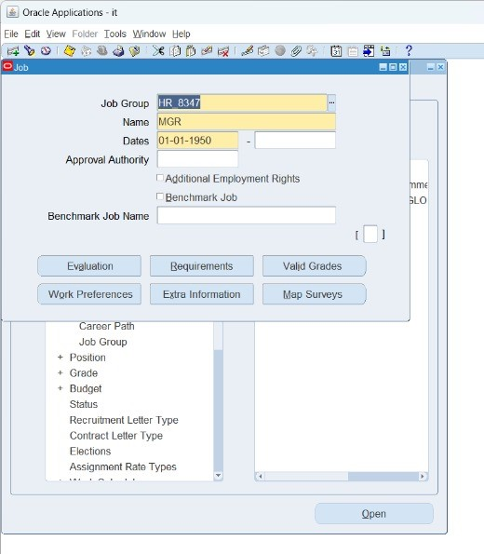
Continue Creating value set
After creating Value Set, We link it with our Business Group as follows:-

Slide 16
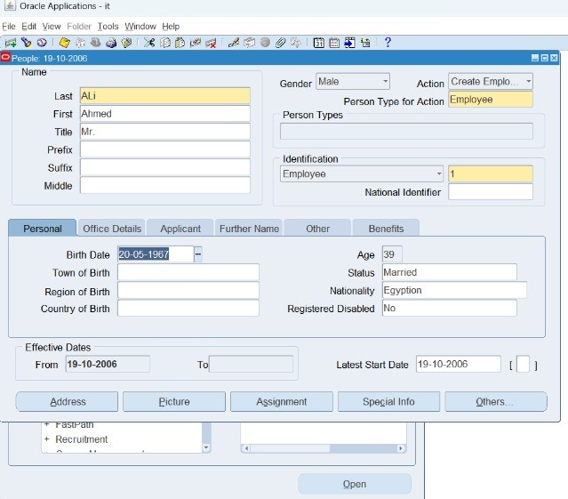
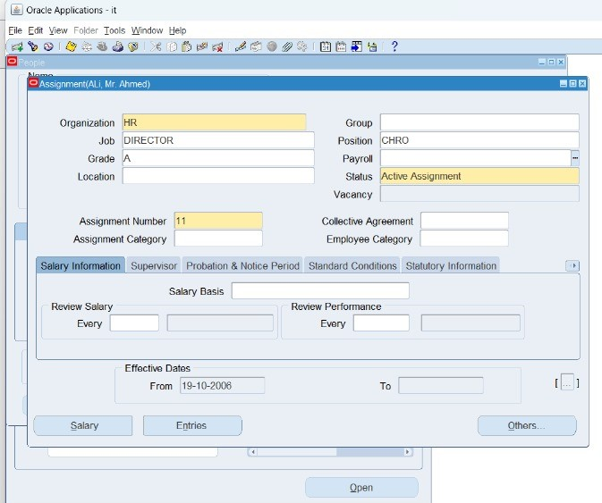
People and Maintain Create Employment
After defining the Business Group, Key Flex Field, Value Sets, Managements, and Departments, now we can create and add employees in the system as follows:-

Slide 17
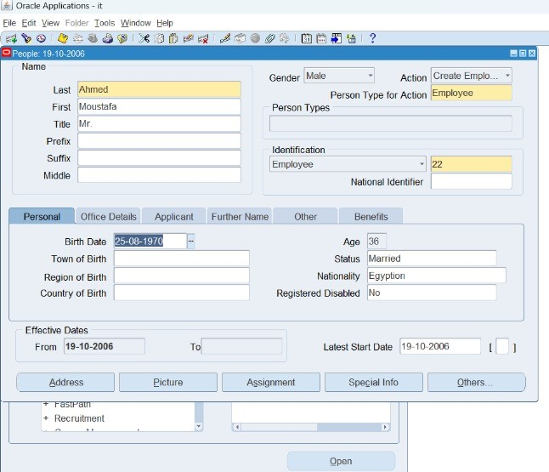
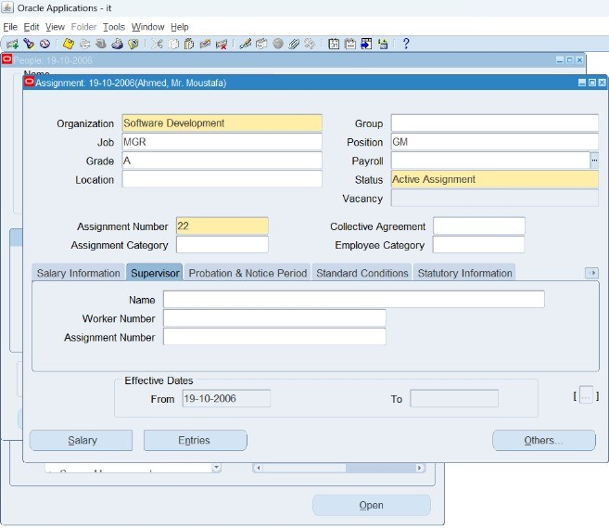
Continue Creating Employment

Slide 18
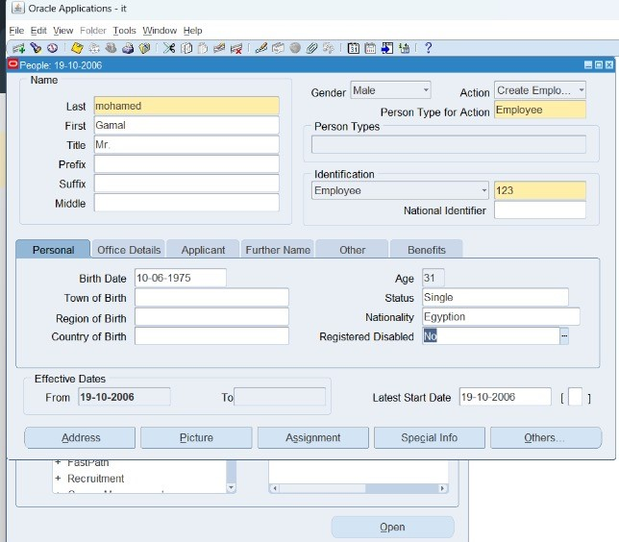
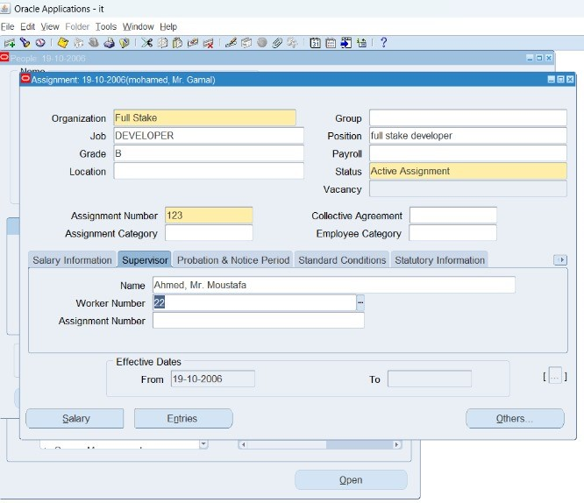
Continue Creating Employment

Slide 19


